Slide 1
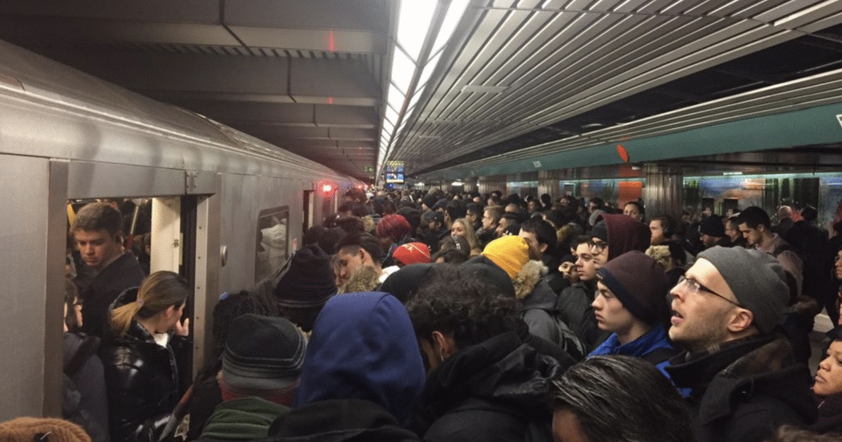

TTC Delays
U of T School of Continuing Studies – Data Analytics Bootcamp
Rohan Chaudhari
Sofiat Ishola
Daniel Cebula
William Lim
Thomas Callegari
July 2019

Slide 2
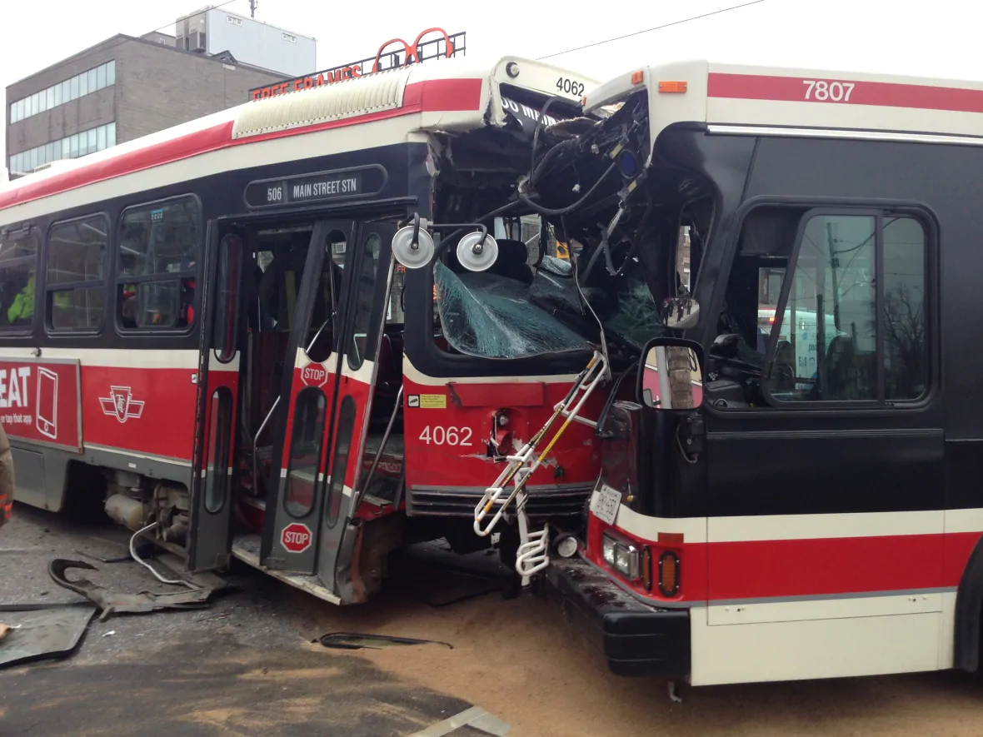
Motivation & Summary
Imagine, you wake up at 6 AM, check Google Maps to plan your commute and see that you have time, you should get to your destination in good time!
You get ready, arrive at your TTC stop and wait …… where is the bus?
Finally! A bus …. You get to the Subway and …
“Attention all customers, we are currently experiencing delays going Westbound … “
We have all been there, stuck on the TTC because of some delay. With this project we are looking to explore TTC (Subway, Streetcar & Bus) delays, narrow in on causes and try to better understand the problems behind the delays.
We will examine relationships between Routes, Day of the Week, Time of Day, Weather and anything else that comes up along the way.

Slide 3
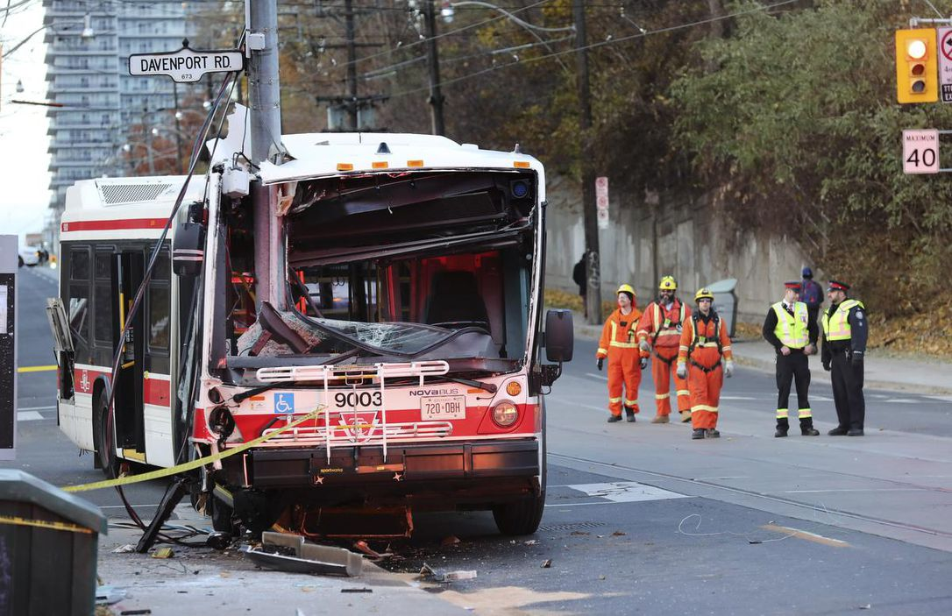
Data Questions
What factors go into TTC Delays?
Does weather impact Subway delays?
How about surface routes (Bus / Streetcar)?
Does day of the week impact Subway delays?
How about surface routes (Bus / Streetcar)?
Is there a seasonal impact?
What is the relationship between delay incidents and weather?

Slide 4
Cleanup & Exploration

Slide 5
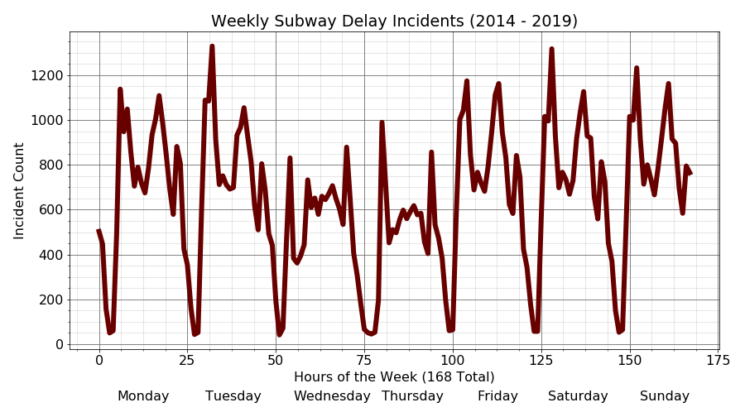
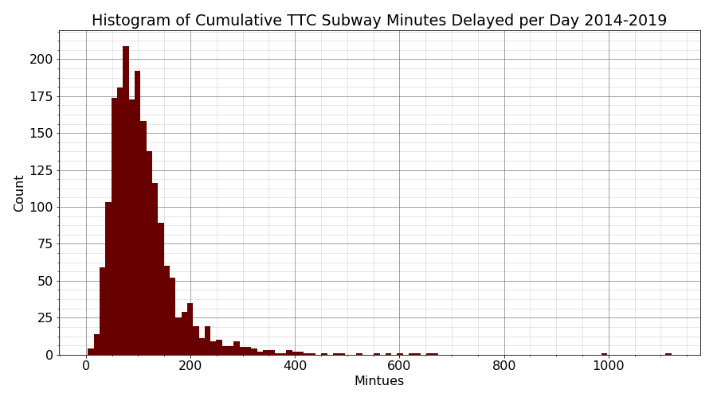
Analysis
Subway Delays
asdf

Slide 6
Analysis

Slide 7
Analysis

Slide 8
Discussion

Slide 9
Post Mortem

Slide 10
Questions?

